Slide 1

Digoxin Reduces 30-Day All-Cause Hospital Admission in Ambulatory Older Patients with Chronic Heart Failure and Reduced Ejection Fraction
ACC Late Breaking Clinical Trial Session
March 11, 2013, San Francisco, CA
Ali Ahmed, Mihai Gheorghiade, Gregg Fonarow, Kanan Patel, Inmaculada Aban, Richard Allman, Jerome Fleg, Robert Bourge
University of Alabama at Birmingham
Veterans Affairs Medical Center
Birmingham, AL

Slide 2
Presenter Disclosure Information
Ali Ahmed, MD, MPH
Digoxin Reduces 30-Day All-Cause Hospital Admission in Ambulatory Older Patients with Chronic Heart Failure and Reduced Ejection Fraction
DISCLOSURE INFORMATION:
No relationships exist related to this presentation
Dr. Ahmed was supported in part by the National Institutes of Health through grants (R01-HL085561, R01-HL085561-S and R01-HL097047) from the National Heart, Lung, and Blood Institute (NHLBI)

Slide 3
The Digitalis Investigation Group (DIG) trial was supported by the NHLBI and the VA Cooperative Studies Program
This article was prepared using a limited access dataset obtained from the NHLBI and does not necessarily reflect the opinions or views of the DIG Study or the NHLBI.
Funding Disclosure Information

Slide 4
New Perspective on an Old Drug
A Very Old Drug

Slide 5
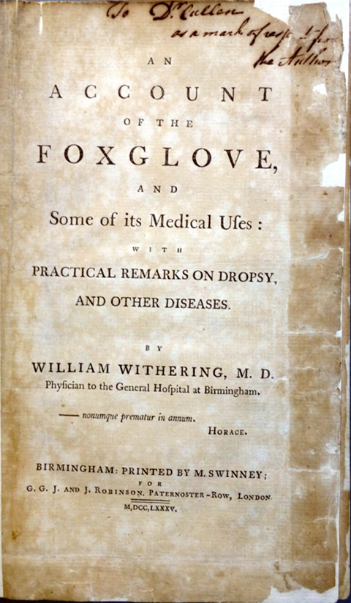

Discovered Over 2 Centuries Ago
An Account of the Foxglove and Some of its Medical Uses
William Withering
1785

Slide 6
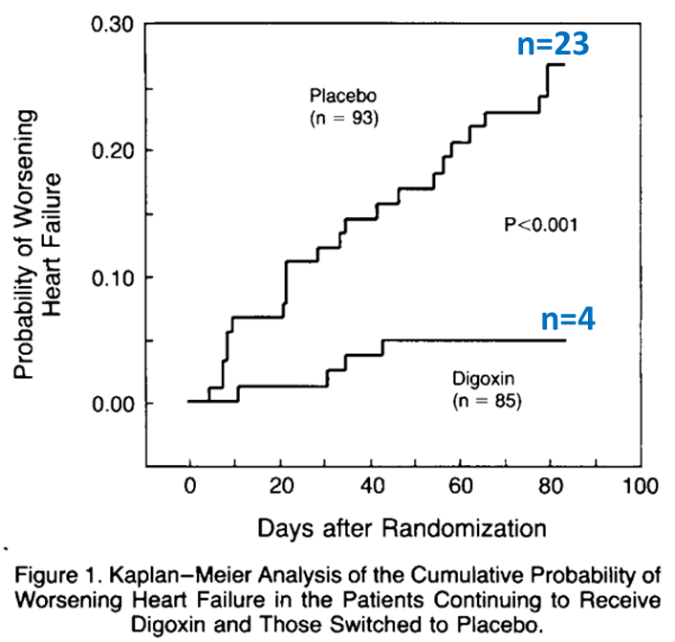
Improves Heart Failure Symptoms
(The RADIANCE Trial)
N=23
Patients whose digoxin was discontinued (in the placebo group) had a higher risk of worsening heart failure (HR, 5.9; 95% CI = 2.1 to 17.2; P<0.001)
N=4
N Engl J Med 1993; 329:1-7

Slide 7
Reduces Risk of Hospital Admission
(The DIG Trial)
 | Placebo (n=3403) | Digoxin (n=3397) | Absolute Risk Difference | Hazard ratio (95% CI) | P value
Heart Failure | 35% | 27% | –8% | 0.72 (0.66–0.79) | <0.001
All-Cause | 67% | 64% | –3% | 0.92 (0.87–0.98) | 0.006
Digoxin significantly reduced the risk of hospitalization due to heart failure by 28% during 37 months of average follow-up, but its effect on hospitalization due to all causes was more modest (a 8% reduction)
N Engl J Med. 1997; 336: 525-33

Slide 8
Does Not Increase Mortality
(The DIG Trial)
HR = 0.99;
95% CI = 0.91–1.07;
P = 0.80
N Engl J Med. 1997; 336: 525-33

Slide 9
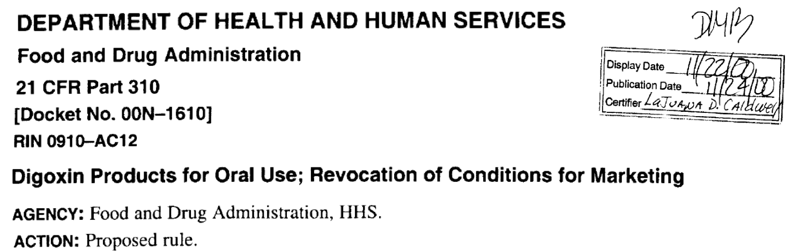
Approved by the FDA
In 1997, FDA approved digoxin for use in heart failure

Slide 10
Recommended by Guidelines
Digitalis can be beneficial in patients with current or prior symptoms of HF and reduced LVEF to decrease hospitalizations for HF
Recommendation Class: IIa
Level of Evidence: B
2009 Focused Update Incorporated Into the ACC/AHA 2005 Guidelines for the Diagnosis and Management of Heart Failure in Adults
JACC. 2009 doi:10.1016/j.jacc.2008.11.013

Slide 11
However, Use Declined
SOLVD (1991): 66%
US Carvedilol (1996): 90%
RALES (1999): 73%
CHARM-Alternative (2003): 45%
RAFT (2010): 35%
EMPHASIS (2011): 27%
over the subsequent decades…in part due to lack of effect on death and downgrade in guideline recommendations

Slide 12
Yet, Heart Failure Remains the Leading Reason for Hospital Admission and Readmission
Condition at Index Discharge | 30-Day All-Cause Readmission | Most Frequent Reason for Readmission
All Medical | 21.0% | Heart Failure (8.6%)
Heart Failure | 26.9% | Heart Failure (37.0%)
All Surgical | 15.6% | Heart Failure (6.0%)
N Engl J Med 2009;360:1418-28

Slide 13
March 2010
The New Health Care Reform Act Signed into Law
Requires CMS to reduce payments to hospitals with excess readmissions, effective October 1, 2012…

Slide 14
October 2012
Medicare imposed about $300 million financial penalties against over 2,000 hospitals that had excessive readmission

Slide 15
Objective
To examine the effect of digoxin on 30-day all-cause hospital admission in older, potentially Medicare-eligible, adults with heart failure and reduced ejection fraction in the main DIG trial

Slide 16
Digitalis Investigation Group (DIG)
Ambulatory chronic heart failure (N=6800)
  Ejection fraction ≤45%
  Normal sinus rhythm
  From United States and Canada
  Randomized to receive either digoxin or placebo
  During 1991-1993
  Followed for an average of 3 years
  >90% on ACE inhibitors and >80% on diuretics
3405 (50% of 6800) were ≥65 years of age

Slide 17
Baseline Characteristics (1)
Variables n (%) or mean (±SD) | Placebo (n=1712) | Digoxin (n=1693) | P value
Age (years) | 72 (5) | 72 (5) | 0.974
Female | 426 (25%) | 415 (25%) | 0.802
Non-whites | 194 (11%) | 180 (11%) | 0.514
Body mass index (kg/m²) | 26.2 (4.7) | 25.9 (4.5) | 0.040
Heart rate (per minute) | 78 (12) | 78 (12) | 0.445
Systolic BP (mm Hg) | 128 (20) | 128 (20) | 0.643
Serum creatinine (mg/dL) | 1.4 (0.4) | 1.4 (0.4) | 0.938
LVEF (%) | 29 (9) | 29 (9) | 0.855
Cardiothoracic ratio | 0.54 (0.08) | 0.54 (0.07) | 0.855
NYHA Class III-IV | 602 (35%) | 603 (36%) | 0.599

Slide 18
Baseline Characteristics (2)
Variables n (%) or mean (±SD) | Placebo (n=1712) | Digoxin (n=1693) | P value
Heart failure duration (mos) | 30 (37) | 30 (38) | 0.625
Prior myocardial infarction | 1168 (68%) | 1154 (68%) | 0.969
Current angina pectoris | 489 (29%) | 465 (28%) | 0.476
Hypertension | 815 (48%) | 784 (46%) | 0.448
Diabetes mellitus | 517 (30%) | 488 (29%) | 0.379
Chronic kidney disease | 1038 (61%) | 1045 (62%) | 0.513
Dyspnea on exertion | 1323 (77%) | 1306 (77%) | 0.924
Dyspnea at rest | 386 (23%) | 358 (21%) | 0.323
4 or more symptoms/signs | 1411 (82%) | 1384 (82%) | 0.525
Pulmonary edema by x-ray | 266 (16%) | 286 (17%) | 0.283

Slide 19
Baseline Characteristics (3)
Variables n (%) or mean (±SD) | Placebo (n=1712) | Digoxin (n=1693) | P value
Dose of study medication
0.125 mg/day | 433 (25%) | 426 (25%)
0.25 mg/day | 1197 (70%) | 1209 (72%) | 0.430
0.375 mg/day or higher | 71 (5%) | 48 (3%)
Pre-trial digoxin use | 739 (43%) | 744 (44%) | 0.646
ACE inhibitors | 1605 (94%) | 1591 (94%) | 0.784
Diuretics | 1405 (82%) | 1374 (81%) | 0.493
Nitroglycerines | 788 (46%) | 768 (45%) | 0.697
Overall, ALL baseline characteristics of patients assigned to digoxin and placebo were balanced except for a slightly lower BMI among those assigned to digoxin

Slide 20
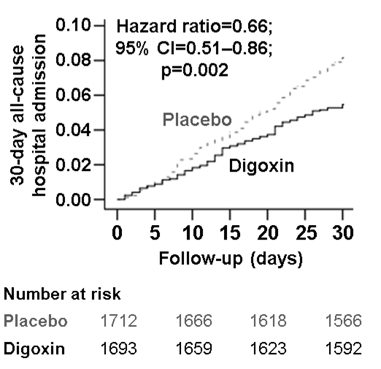
Kaplan-Meier Plot
30-Day All-Cause Hospital Admission
Follow-up in Days

Slide 21
30-Day Hospital Admission
Due to All Causes
Placebo (n=1712) | Digoxin (n=1693) | Absolute Risk Difference | Hazard ratio (95% CI) | P value
8.1% | 5.4% | –2.7% | 0.66 (0.51–0.86) | 0.002
In the 30 days after randomization, in patients assigned to digoxin, the absolute risk and relative risk for all-cause hospital admission was reduced by an 2.7% and 34%, respectively

Slide 22
60-Day and 90-Day
All-Cause Hospital Admission
 | Hazard ratio (95% CI) | P value
At 60 days | 0.76 (0.63–0.91) | 0.003
At 90 days | 0.75 (0.63–0.88) | <0.001
The effect of digoxin on 30-day all-cause hospital admission persisted during 60 and 90 days after randomization, suggesting the early benefit of digoxin was not at the cost of later harm

Slide 23
30-Day Hospital Admission
Due to Cardiovascular Causes
Placebo (n=1712) | Digoxin (n=1693) | Absolute Risk Difference | Hazard ratio (95% CI) | P value
6.5% | 3.5% | –3.0% | 0.53 (0.38–0.72) | <0.001
In the 30 days after randomization, digoxin reduced the risk of hospital admission due to cardiovascular causes by 47%

Slide 24
30-Day Hospital Admission
Due to Worsening Heart Failure
Placebo (n=1712) | Digoxin (n=1693) | Absolute Risk Difference | Hazard ratio (95% CI) | P value
4.2% | 1.7% | –2.5% | 0.40 (0.26–0.62) | <0.001
In the 30 days after randomization, digoxin reduced the risk of hospital admission due worsening heart failure by 60%

Slide 25
30-Day Mortality
 | Hazard ratio (95% CI) | P value
All-cause | 0.55 (0.27-1.11) | 0.096
Cardiovascular | 0.64 (0.31-1.31) | 0.222
Progressive heart failure | 0.22 (0.05-1.04) | 0.056
Although few deaths (n=34) occurred, they were numerically fewer in the digoxin group (0.7% vs. 1.3% for placebo)…

Slide 26
30-Day Combined Outcomes
Placebo (n=1712) | Digoxin (n=1693) | Absolute Risk Difference | Hazard ratio (95% CI) | P value
8.7% | 6.0% | –2.7% | 0.69 (0.53–0.88) | 0.003
…consequently, the composite outcome of all-cause hospitalization or all-cause death at 30 days also was reduced substantially (by 31%)
Only 4 patients were hospitalized because of suspected digoxin toxicity within 30 days of randomization, of whom 3 were from the digoxin group

Slide 27
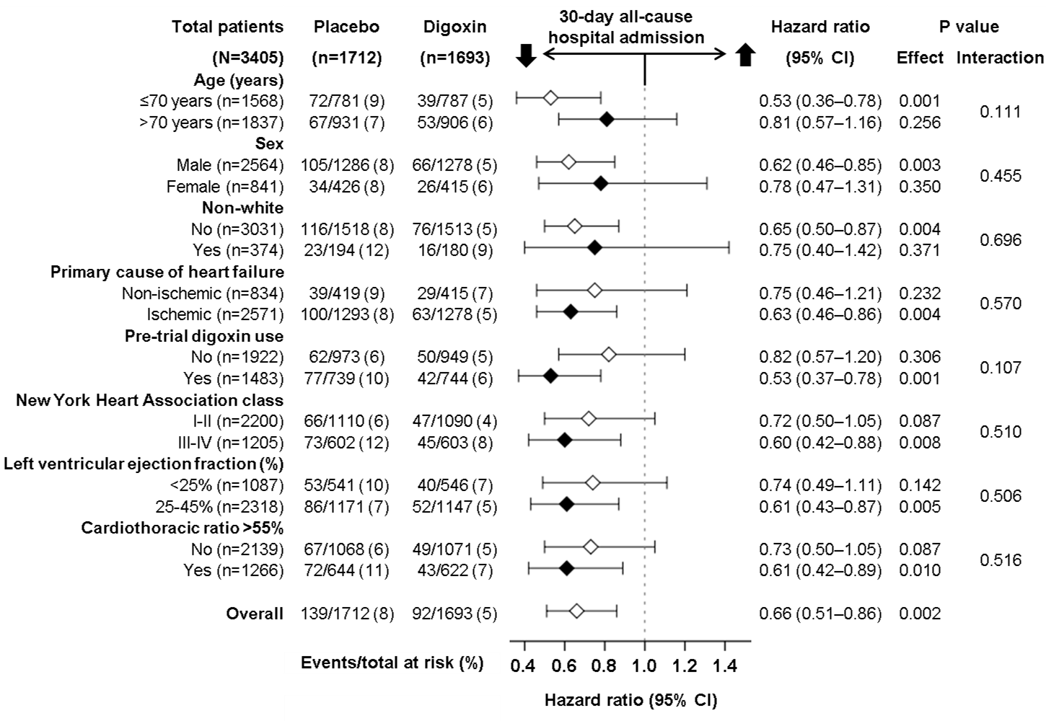
Subgroup Analyses

Slide 28
Study Limitations
Post hoc analysis of RCT
Generalizability concerns
  Ambulatory vs. post-discharge
  Admission vs. re-admission
  HFrEF vs. HFpEF
  Not receiving beta-blockers
  Not receiving aldosterone antagonists

Slide 29
Conclusions
Digoxin reduced the risk of 30-day all-cause hospital admission in ambulatory older adults with chronic systolic heart failure receiving ACE inhibitors and diuretics
If these findings can be replicated in contemporary older heart failure patients discharged from hospital after acute decompensation, digoxin may provide an inexpensive tool to reduce 30-day all-cause hospital readmission

Slide 30

As Sir Withering Predicted in 1785
“After all, in spite of opinion, prejudice or error, Time will fix the real value upon this discovery, and determine whether I have imposed upon myself and others, or contributed to the benefit of science and mankind.”
Dr. William Withering (1741-1799)

Slide 31

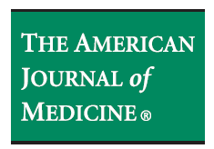



Advance Access Online Publication March 11, 2013

